Slide 1
CREATE TABLE IN HANA.
Milind Parab

Slide 2
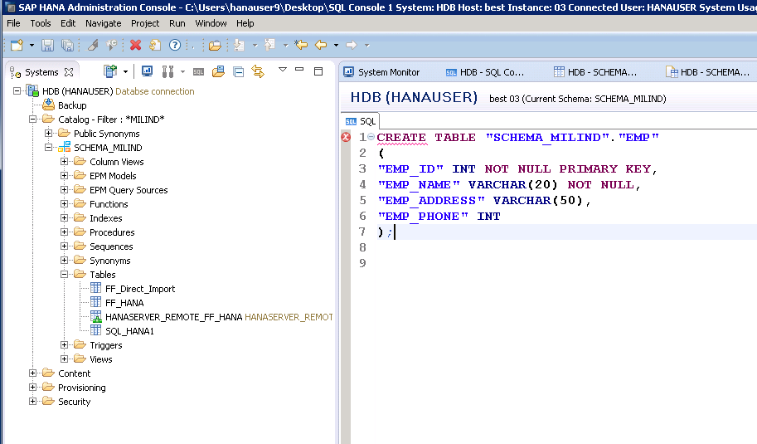
Create Table in HANA.

Slide 3
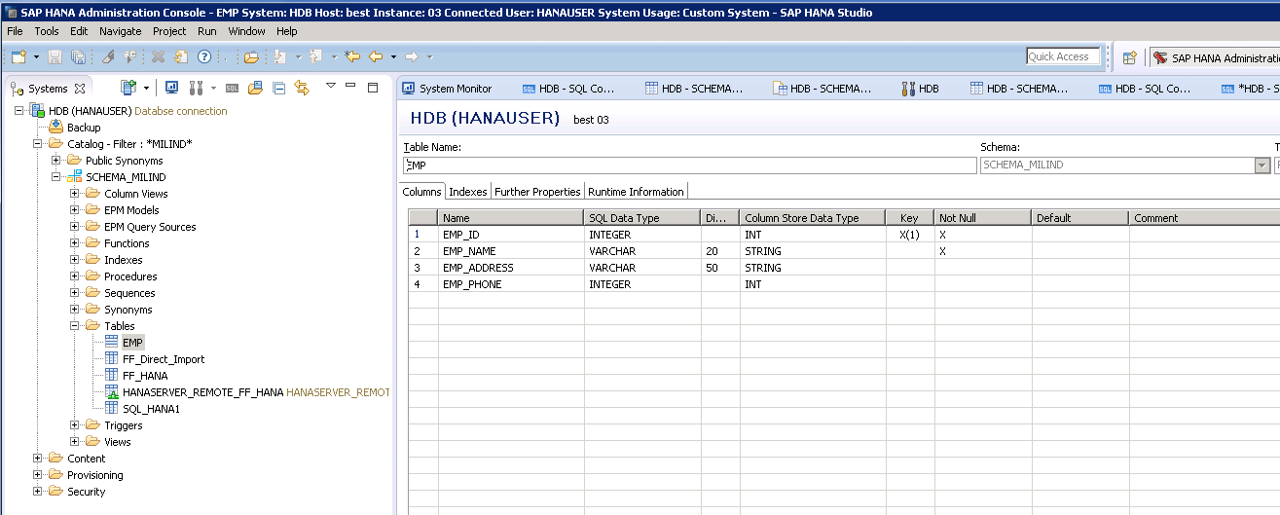
Table has been created.

Slide 4
ALTER TABLE.
Milind Parab

Slide 5
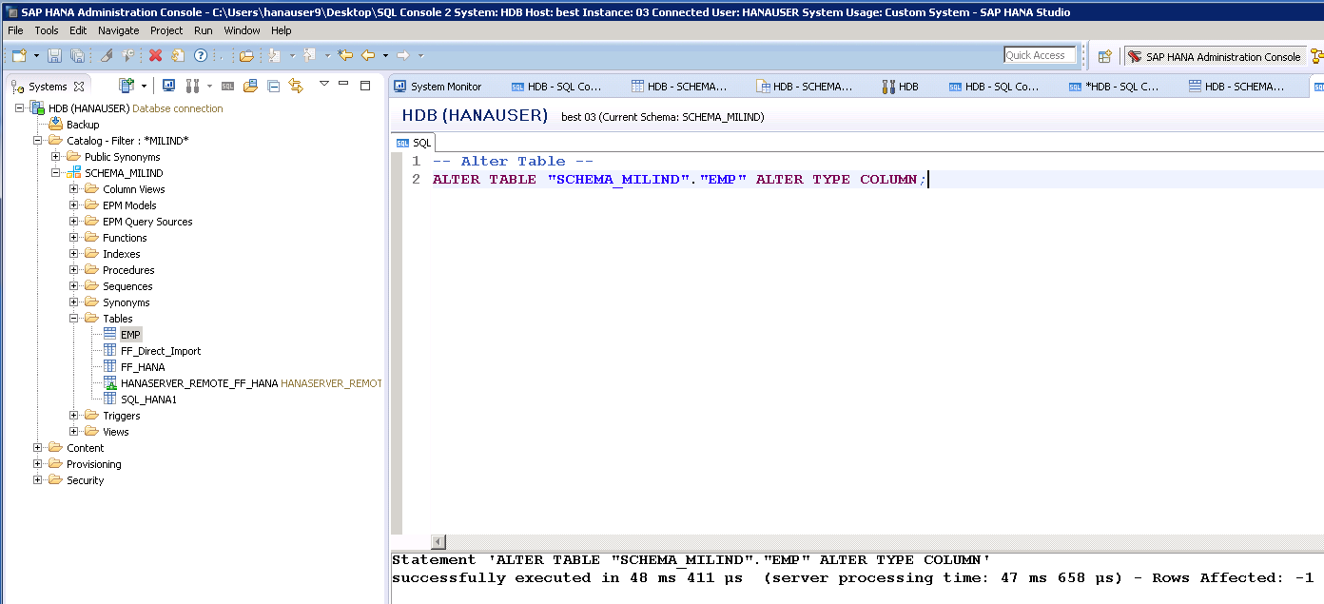
Alter Table Type.

Slide 6
Insert values.
Milind Parab

Slide 7
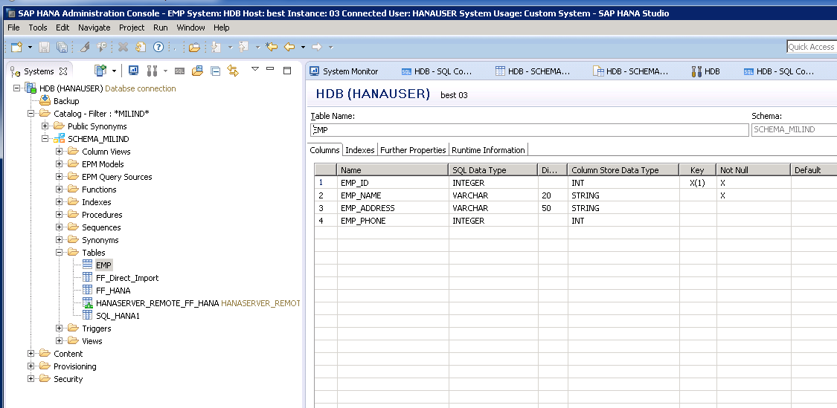
Table definition.

Slide 8
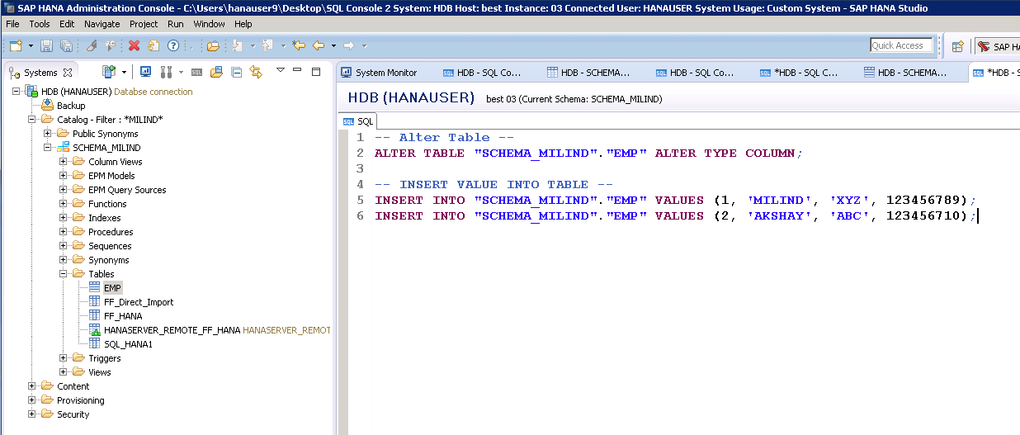
Cont.

Slide 9
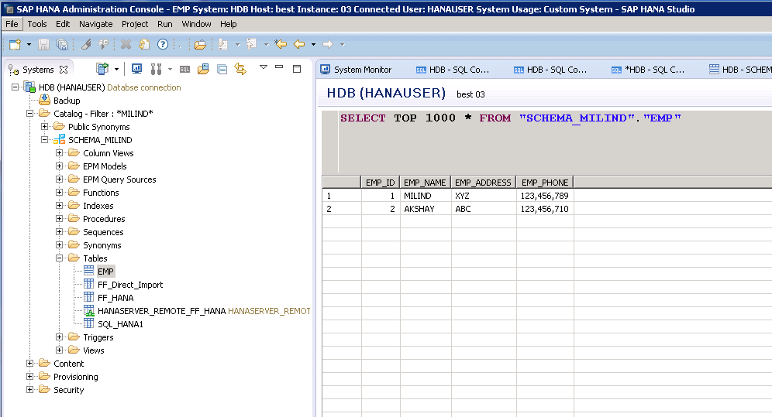
Table Content.

Slide 10
COPY TABLE
Milind Parab

Slide 11
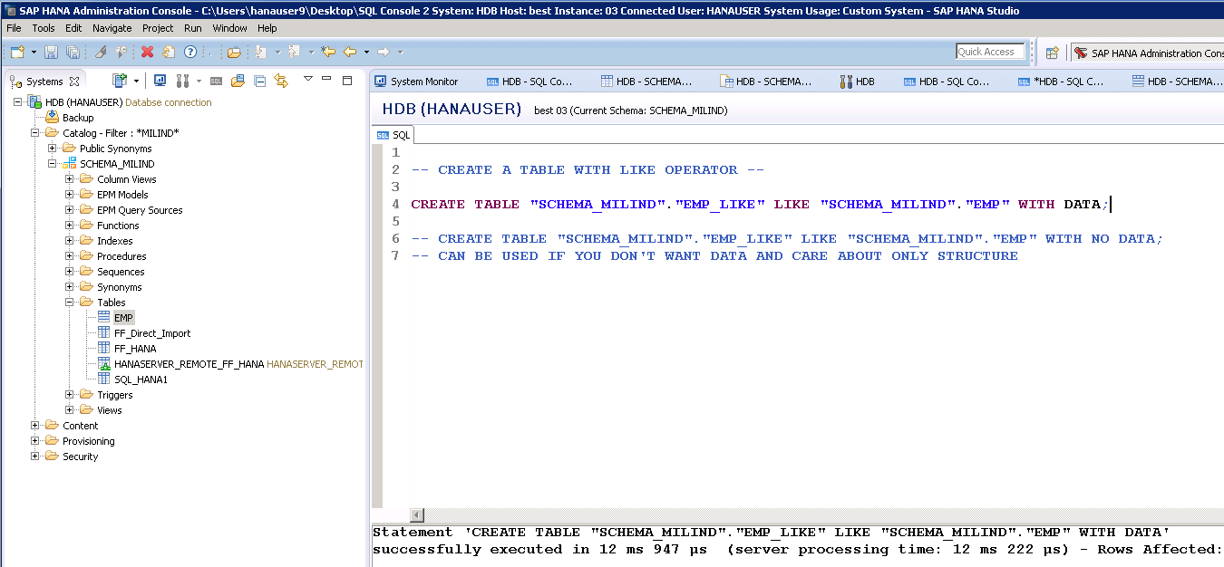
Cont.

